Slide 1
Event Detection
Jiannong Cao
Internet and Mobile Computing Lab
Hong Kong Polytechnic University

Slide 2

Outline
Motivation
Related works
Basic idea
Protocol illustration

Slide 3
Motivation
Need to design energy efficient event detection protocol for the pub/sub middleware
No existing work on event detection protocols for WSN

Slide 4
Related Works
No existing work on event detection for WSN but there are a lot of works on data aggregation. Some of the ideas may be borrowed.
The difference between data aggregation and event detection is that event detection needs to take temporal constraints into consideration.
LEACH and PEGASIS:
  Assume the sensor nodes may adjust power and they may be able to directly communicate with sink
  PEGASIS improves LEACH by using a chain structure
AIDA and DAA:
  Data aggregation at the MAC layer

Slide 5
Related Works
Database solutions (TAG, GaNC/TiNA])
  Consider how to implement the aggregate functions commonly used in database such as sum() and average().
Math-based solutions (Statistical Aggregation, q-digest, Deterministic Weighted Sampling):
  Improved the database solution by supporting other aggregate functions such as median and histogram.
  Usually trade-off between accuracy and cost
Sparse Aggregation:
  Use double ruling to aggregate the data sparsely distributed in an area.

Slide 6

Basic Idea
Energy-efficient event detection can be done when the event information is considered:
  When events have sequence relationship, some sensor nodes can stay inactive until the triggering event is detected by other nodes.
Required Information
  Event information
  Provide a language expressive enough

Slide 7
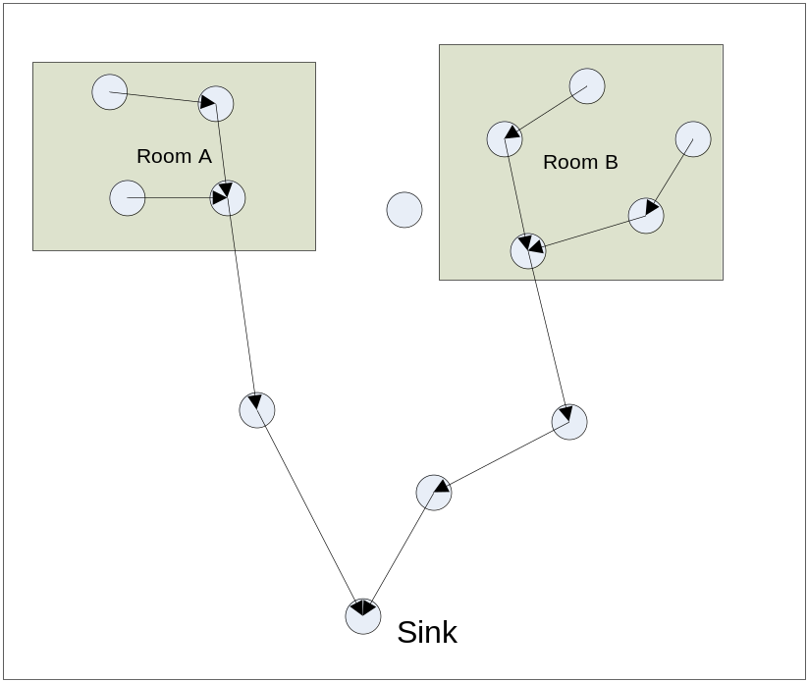
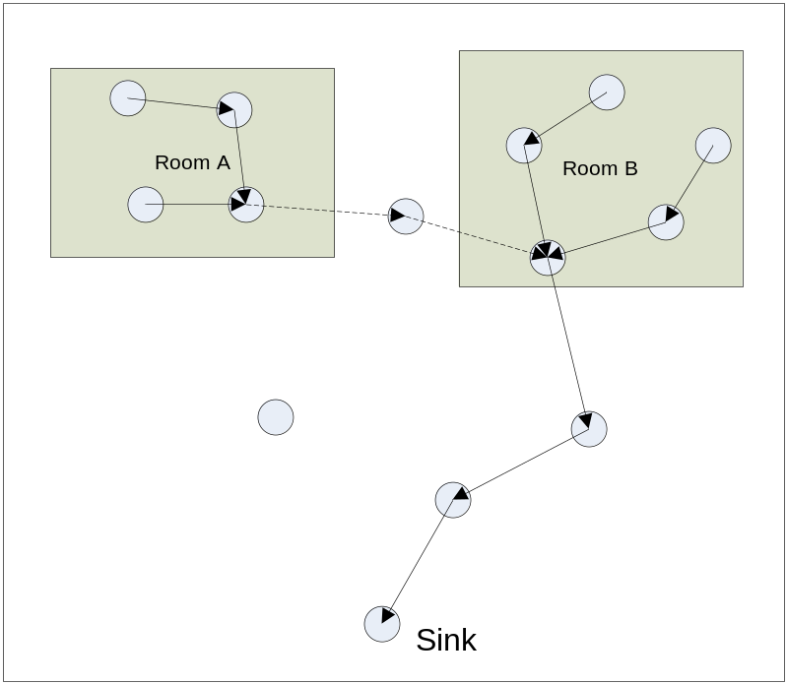
Basic Idea – Scenario
Example: Detect a composite event such that the temperature of room A rises above 30 then after 10 minutes, the temperature of room B also rises above 30.

Slide 8
Basic Idea
Analysis of the scenario
  Two events need to be detected in sequence in order to detect the composite event
  The sensors which can detect the temperature in room B can stay inactive until the sensors in room A has detected the event.

Slide 9
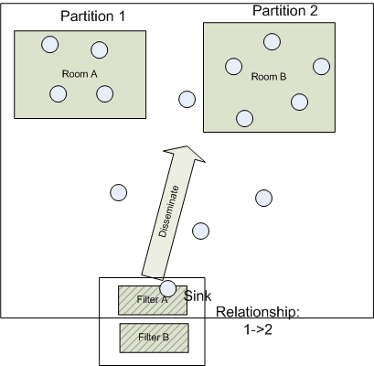
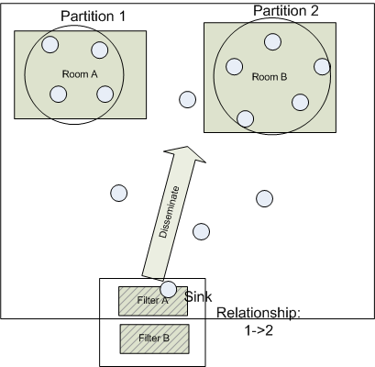
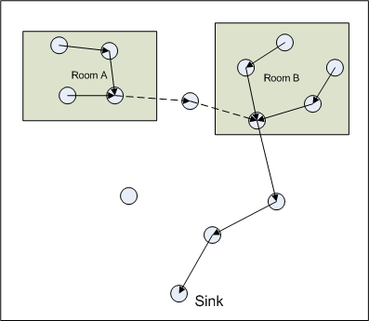
Protocol Illustration 1

Slide 10
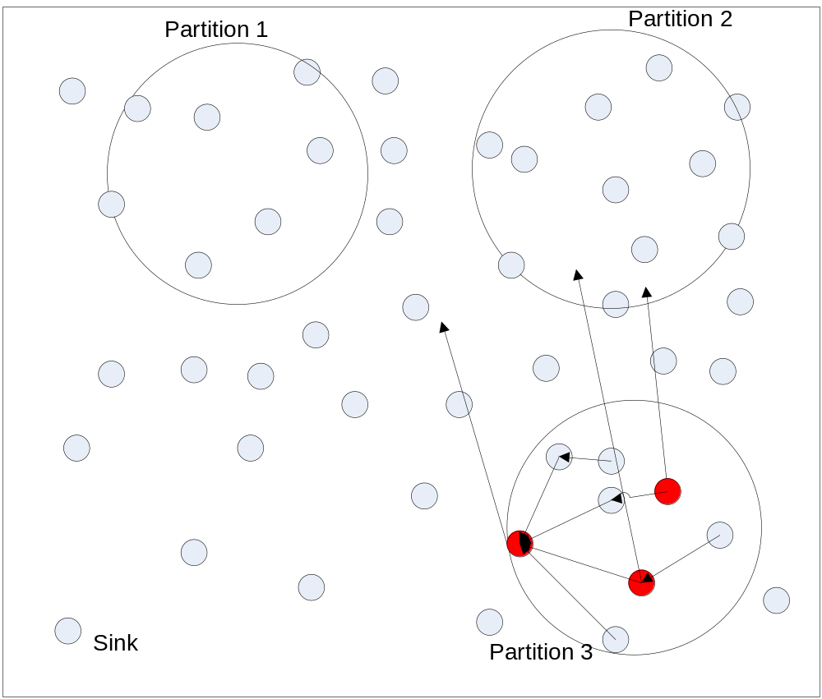
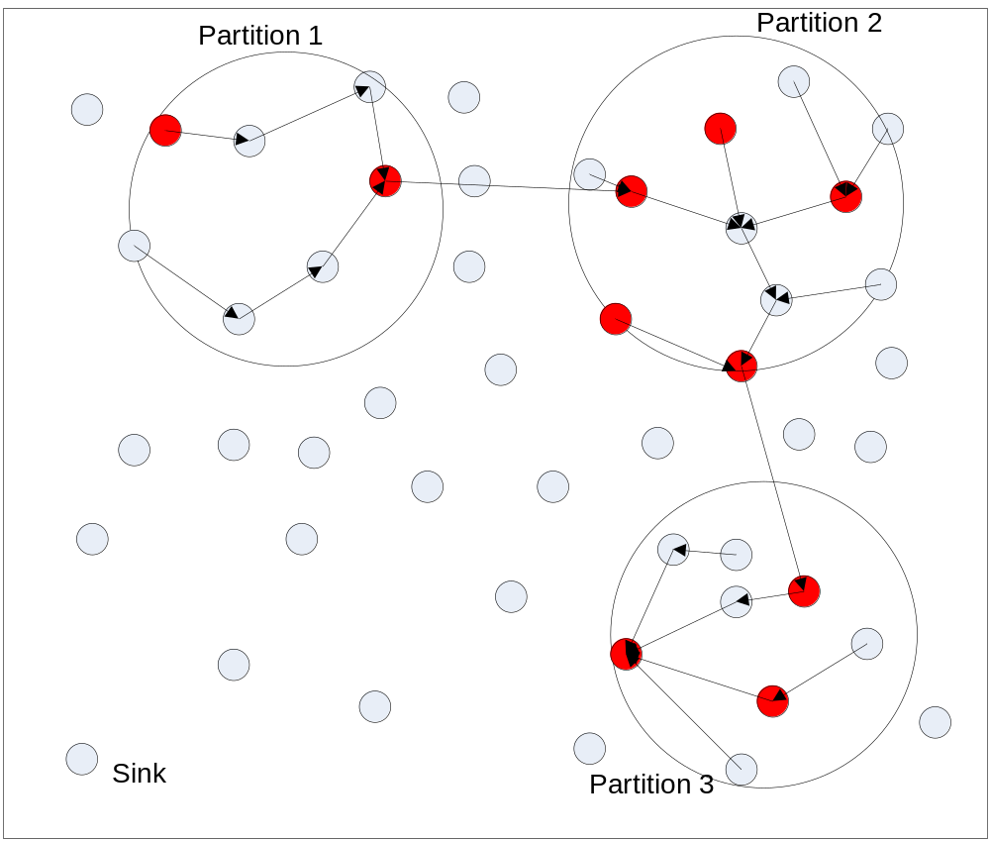
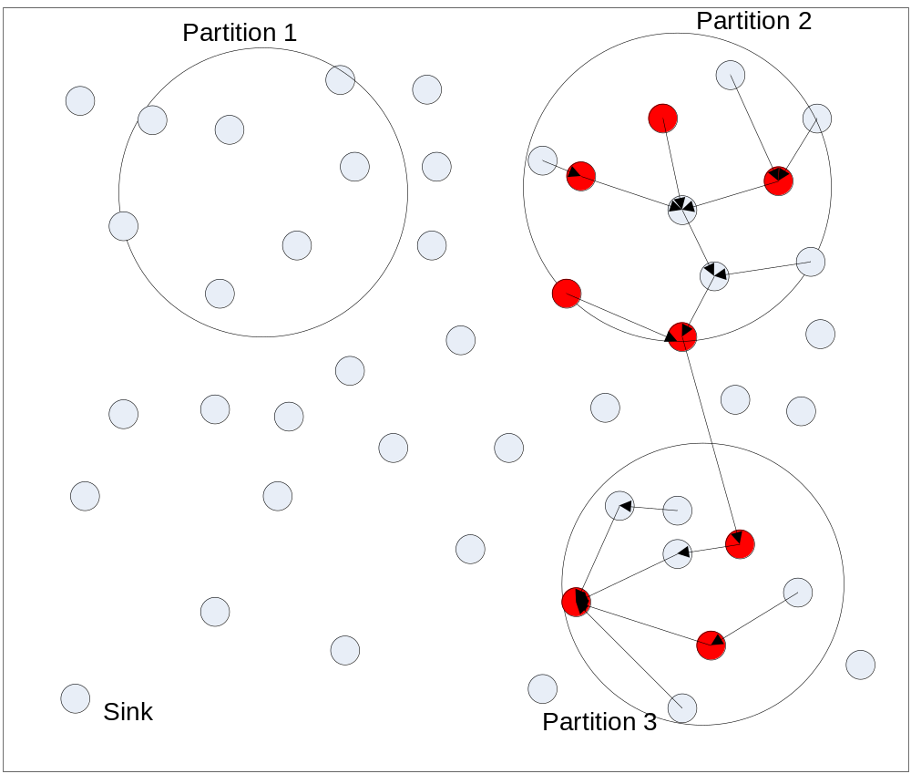
Protocol Illustration 2

